Slide 1
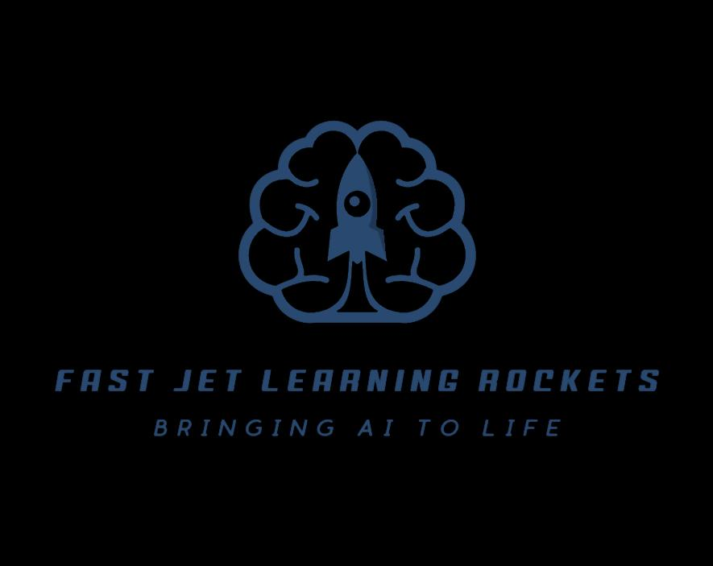
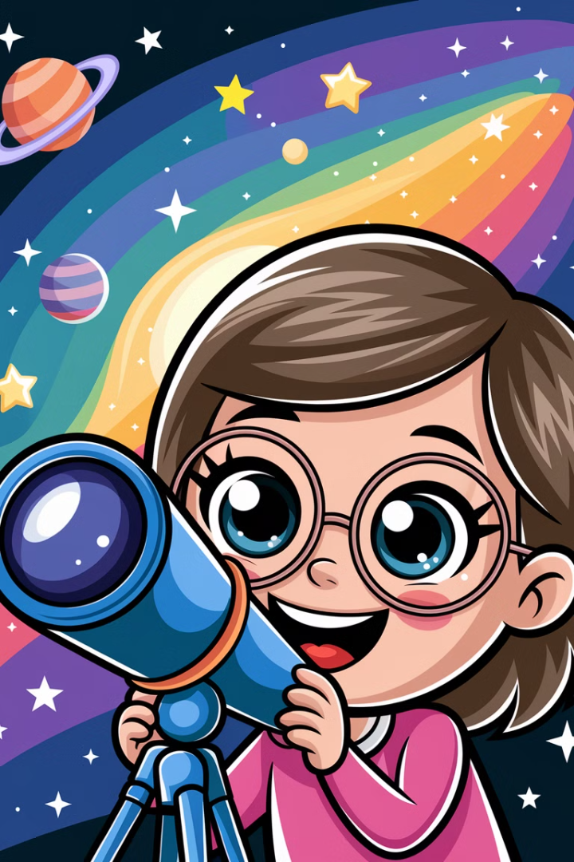
Understanding Tensors:
The Magic Behind AI & Science!
Who loves AI, video games, or exploring space?
This presentation is for you! We will explore tensors, the superpower behind all these cool things. Let's dive into the world of superpowered numbers!

Slide 2
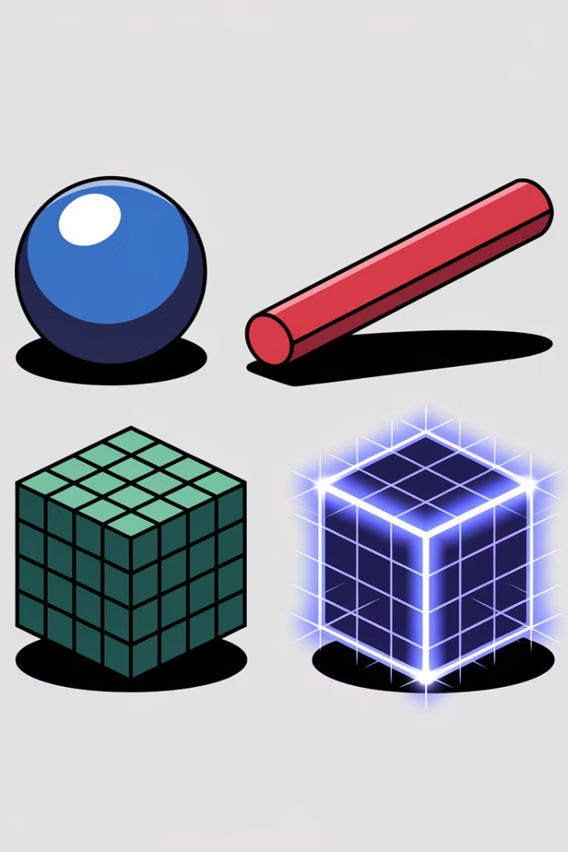
What Are Tensors?
The Superpower Behind AI, Games, and Space!
Scalar (0D)
Vector (1D)
Matrix (2D)
A single number, like 5.
A list of numbers, like [2, 4, 6].
A grid of numbers, like [[1,2], [3,4]].
Tensors are like 3D boxes of numbers. They help computers learn and make decisions.

Slide 3
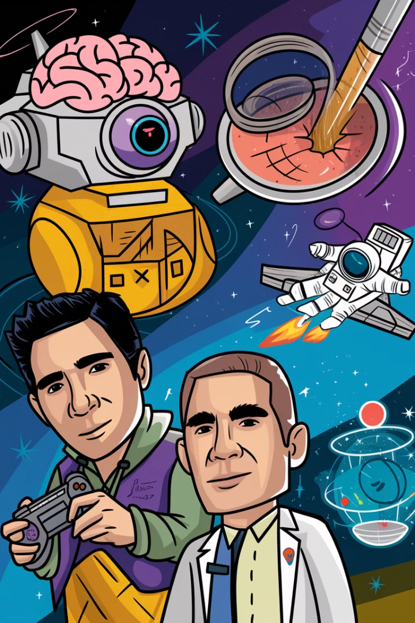
Tensors = Superpowered Numbers!
AI & Machine Learning
ChatGPT, Google Translate, Siri all use tensors.
Video Games
3D graphics in Minecraft, Fortnite, GTA rely on tensors.
Medicine
AI-powered X-rays and MRI scans use tensors.
Space Science
NASA simulations of black holes use tensors.
Tensors are everywhere! Can you guess another place where tensors might be used?

Slide 4
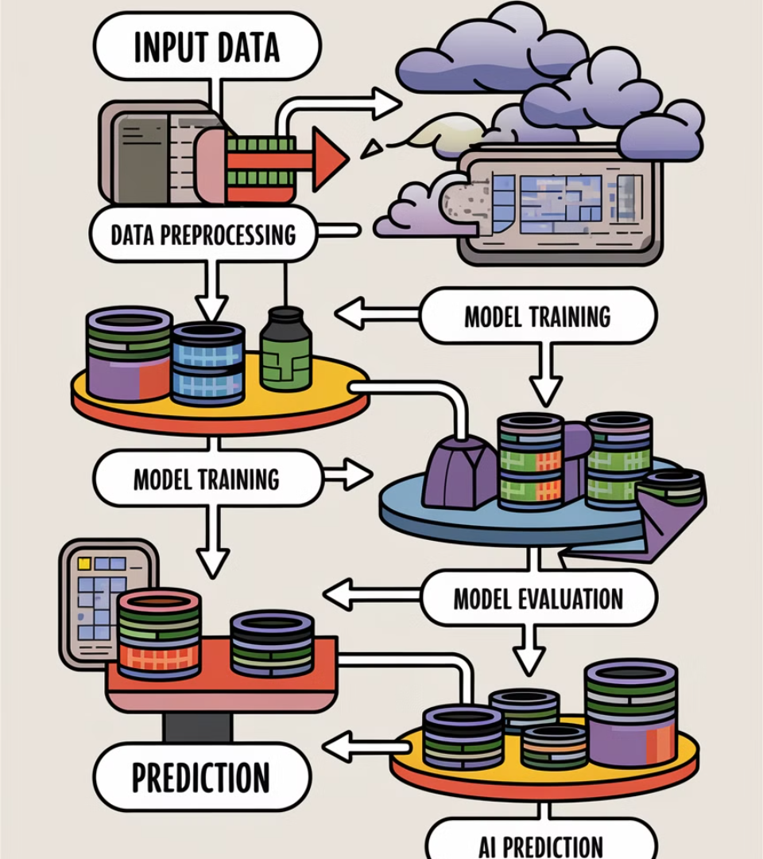




Where Are Tensors Used?
AI sees words, images, or sounds
Converts them into numbers (tensors!)
Learns from patterns
Makes smart predictions
AI thinks using tensors! It sees words, images, or sounds. Then, it converts them into numbers and learns from patterns. Finally, it makes smart predictions.

Slide 5

AI Thinks Using Tensors!
1
Too Big!
Large tensors slow down AI.
2
Hard to Understand!
AI’s decisions aren’t always clear.
3
Too Slow!
Real-time AI like self-driving needs faster tensors.
4
Can Make Mistakes!
AI learns biases from bad data.
Are tensors perfect? Not yet! They can be too big, hard to understand, and too slow. Also, they can make mistakes if they learn from bad data.

Slide 6

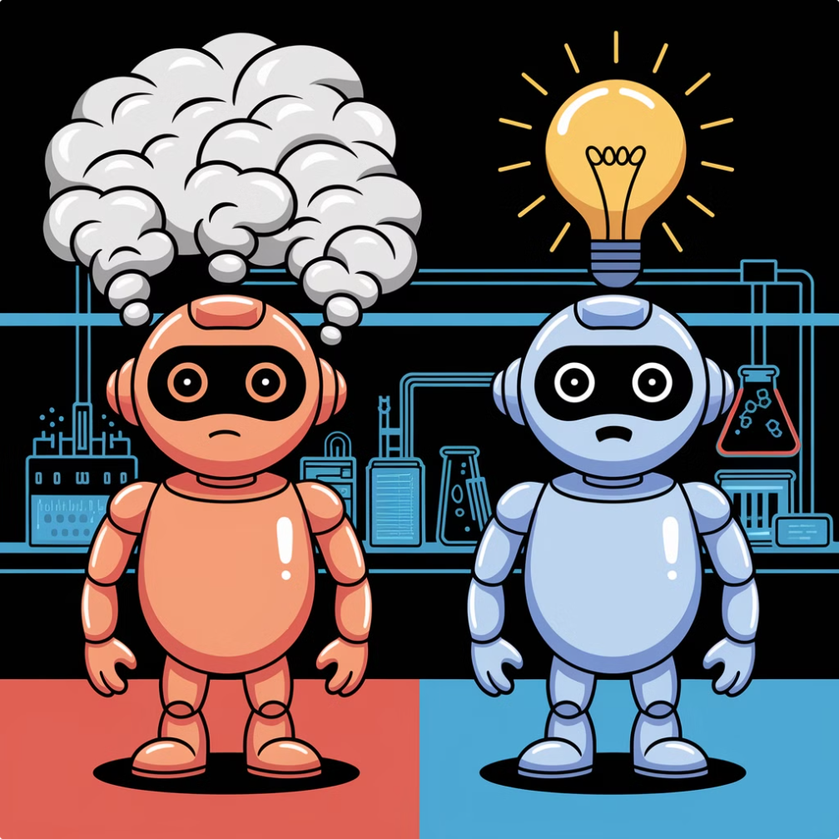




Limitations of Tensors
Better Processors!
Explainable AI!
Compression!
TPUs and GPUs speed up AI calculations.
Tools like TensorBoard help humans see how AI learns.
Shrinking tensors for faster computing.
Ethical AI!
Detecting and removing AI biases.
We're making tensors smarter! This is achieved using better processors, Explainable AI, compression, and ethical AI.

Slide 7
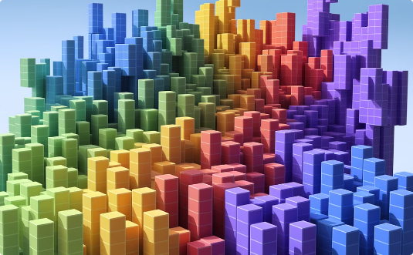
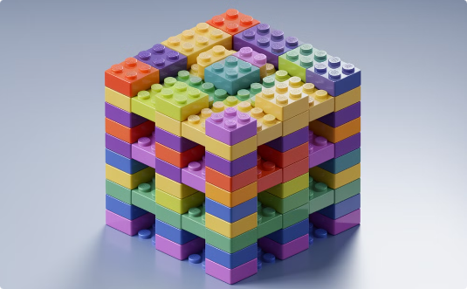
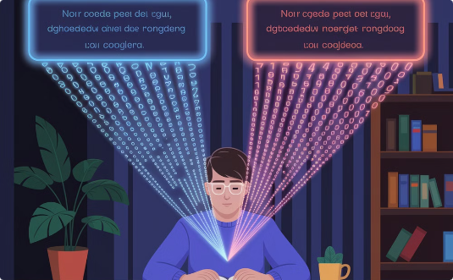
Making Tensors Smarter!
Minecraft Magic
Lego Tensor Game
Translation in Action
See how Minecraft uses tensors to track every block's position in a giant 3D grid!
Build your own tensor by stacking Legos in rows, columns, and 3D layers!
Watch Google Translate use tensors to change sentences between languages!
Let's play with tensors in these fun, hands-on ways! Each example shows how tensor math powers the technology we use every day.

Slide 8

Let's Play with Tensors! 🎮
1
Everywhere
Tensors are everywhere in AI, games, space, and healthcare.
2
Computers Think
They help computers think and learn.
3
Limitations
Scientists are solving their limitations to make AI faster and fairer.
Tensors are the future of AI! They help computers think and learn. Scientists are solving their limitations. This makes AI faster and fairer.

Slide 9


Tensors = The Future of AI! Time for a tensor quiz!
1
2
What is the Tensors?
Where are tensors used?
(A) AI
(A) A 3D box of numbers
(B) Space
(B) A spaceship
(C) Medicine
(C) A video game
(D) All of the above
3
What problem do tensors face?
(A) They are too small
(B) They can be slow and biased

Slide 10
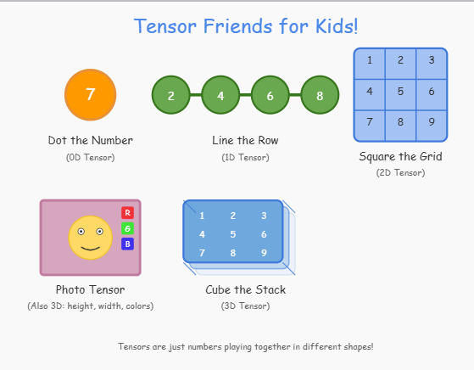

Slide 11

Story Time
Tensor Town:
The Magical Building Blocks of AI!

Slide 12
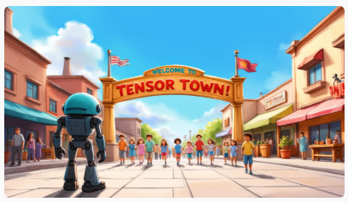
AI ROBOT welcomes visitors at wide view of the entrance to Tensor Town, with colorful signs and playful architecture
HEH WELCOME, YOUNG EXPLORERS!

Slide 13
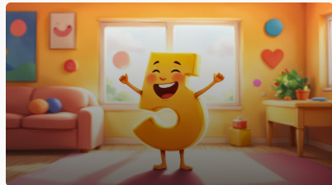
In a bright and colourful room, a small smiling number '5' (Scaly the Scalar) standing in the centre, warningly said:
HI, I AM SCALY THE SCALAR!

Slide 14
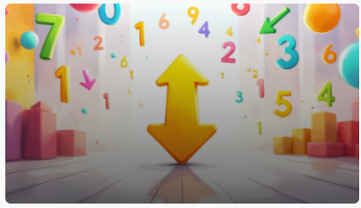
VICKY stands in the center of the room, surrounded by colorful numbers and arrows pointing in different directions, said:
HOLA! I’M VICKY THE VECTOR!

Slide 15
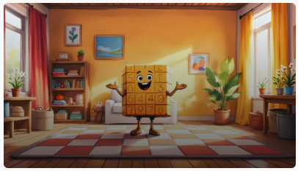
MATT stands in the centre of the room, depicted as a large chessboard of numbers smilingly greeted:
HELLO! I’M MATT THE MATRIX!

Slide 16
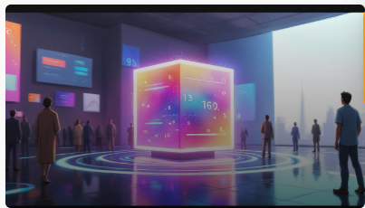
TERRY, a colorful 3D cube with numbers, positioned in the centre, surrounded by various digital elements representing information in multiple dimensions exclaimed:
HI Y’ALL! I’M : I’m TERRY THE TENSOR!

Slide 17
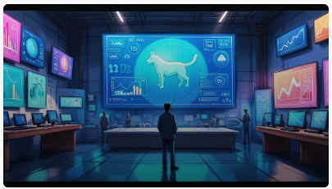
The AI LAB filled with advanced technology, screens displaying data and diagrams about Tensors. A large screen shows an AI recognizing a cat, with numbers and graphs illustrating the process. AI ROBOT implied:
TENSORS HELP AI SEE, HEAR, AND THINK!

Slide 18
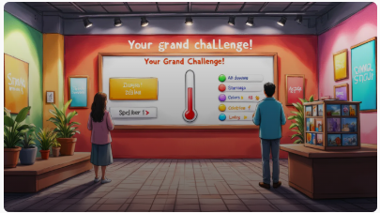
In a brightly lit QUIZ ROOM, a large quiz board displays the title 'Your Grand Challenge!‘ featured a single temperature reading displayed, alongside a list of words and a grid of colors in a picture. A cube storing multiple photos sits on a nearby table, inviting fun-quiz game interaction.

Slide 19
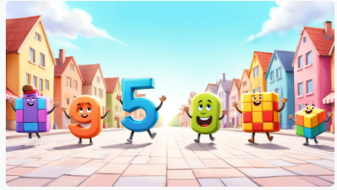
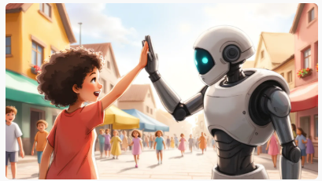
Scaly, Vicky, Matt, Terry, Kids and an AI ROBOT happily concluded their adventurous journey with singing their favourite Tensor song
One, two, three, four,
Numbers we can all explore!
Just one number is a dot,
In a row they like a lot.
One, two, three, four,
Numbers we can all explore!
Make a square with numbers too,
Like a game of peek-a-boo!
Stack them up to make a cube,
Now we're learning, that's the truth!
Dot and line and square and cube,
That's how tensors help computers too!

Slide 20
STATEMENT OF CONTRIBUTION
GROUP MEMBERS | CONTRIBUTION
FAIZA ABDULLAH | Wrote Song Script Developed two variants of Song Developed Story Board Developed Video Did finishing and added story board to the presentation
JONAH JOSEPH | Was supposed to fully do this assignment, submitted presentation with just 2-3 preliminary slides
LYAZZAT ZILGARINA | Researched for the topic Developed Presentation
RYAN YAUCH | N/A (at eleventh hour we had to do this assignment, he was focussing on team’s next assignment)

